Slide 1

Extension
Chart
Laravel Framework

Slide 2

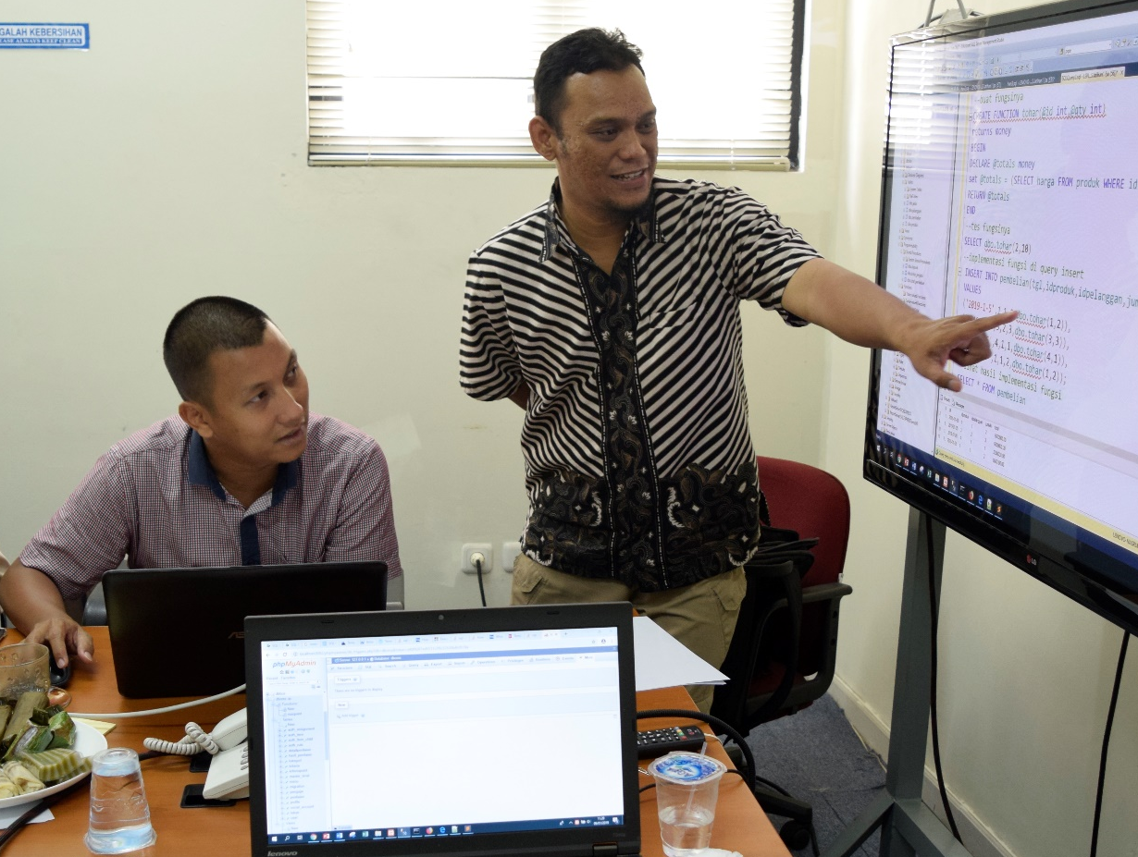
Nasrul, S.Pd.I, S.Kom, M.Kom
Dosen Tetap STT Nurul Fikri
Instruktur IT NF Computer
Instruktur IT Sekolah Programmer YBM PLN
Instruktur IT Fast Com
Programmer

Slide 3
Buat Controller Baru (Dashboard)

Slide 4
Buat Fungsi di DashbordController
<?php
namespace App\Http\Controllers;
use App\Models\Pegawai;
use DB;
use Illuminate\Http\Request;
class DashboardController extends Controller
{
public function index()
{
$ar_kekayaan = DB::table('pegawai')->select('nama','kekayaan')->get();
$ar_gender = DB::table('pegawai')
->selectRaw('gender, count(gender) as jumlah')
->groupBy('gender')
->get();
return view('dashboard.index', compact('ar_kekayaan','ar_gender'));
}
}

Slide 5
Buat Route di routes/web.php
use App\Http\Controllers\DashboardController;
Route::get('dashboard', [DashboardController::class,'index']);

Slide 6
Buat Menu di admin/sidebar.blade.php
<aside id="sidebar" class="sidebar">
<ul class="sidebar-nav" id="sidebar-nav">
<li class="nav-item">
<a class="nav-link " href="{{ url('dashboard') }}">
<i class="bi bi-grid"></i>
<span>Dashboard</span>
</a>
</li><!-- End Dashboard Nav -->

Slide 7
Buat File index.blade.php
di views/dashboard – Grafik Bar(1)
@extends('admin.index')
@section('content')
{{-- ISI KONTEN GRAFIK --}}
@endsection

Slide 8
Buat File index.blade.php
di views/dashboard – Grafik Bar(2)
<h5 class="card-title">Grafik Kekayaan Pegawai</h5>
<!-- Bar Chart -->
<canvas id="barChart" style="max-height: 400px;"></canvas>
<script>
//ambil data nama pegawai dan kekayaan dari DashboardController di fungsi index
var lbl = [@foreach($ar_kekayaan as $harta) '{{ $harta->nama }}’,
@endforeach];
var hrt = [@foreach($ar_kekayaan as $harta) {{ $harta->kekayaan }},
@endforeach];
document.addEventListener("DOMContentLoaded", () => {
new Chart(document.querySelector('#barChart'), {
type: 'bar',
data: {
labels: lbl,
datasets: [{
label: 'Harta Kekayaan Pegawai',
data: hrt,

Slide 9
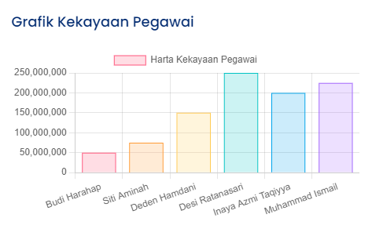
Tampilan Grafik Batang
Notes:
http://localhost:8000/dashboard

Slide 10
Buat File index.blade.php
di views/dashboard – Grafik Pie
<h5 class="card-title">Grafik Perbandingan Gender Pegawai</h5>
<!-- Pie Chart -->
<canvas id="pieChart" style="max-height: 400px;"></canvas>
<script>
//ambil data gender dan jumlah gendernya dari DashboardController di fungsi index
var lbl2 = [@foreach($ar_gender as $g) '{{ $g->gender }}’, @endforeach];
var jml = [@foreach($ar_gender as $g) {{ $g->jumlah }}, @endforeach];
document.addEventListener("DOMContentLoaded", () => {
new Chart(document.querySelector('#pieChart'), {
type: 'pie',
data: {
labels: lbl2,
datasets: [{
label: 'My First Dataset',
//data: [300, 50, 100],
data: jml,

Slide 11
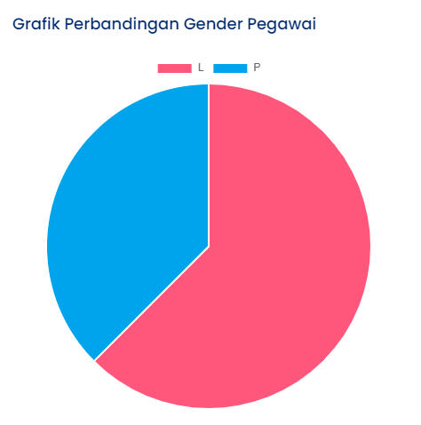
Tampilan Grafik Pie
Notes:
http://localhost:8000/dashboard

Slide 12
Referensi
https://laravel.com/
Notes:
Referensi web diakses terakhir melalui websitenya pada November 2022.

